Slide 1
Data Splash
Andy Gray 445348
Viva

Slide 2
Overview
Objectives
Project Proposal
Background
Design
Implementation
Results
Conclusion
Future Work

Slide 3
Objectives
Must provide the users with an interactive GUI, allowing them to be able to navigate through the application and interact with its contents.
The application must have a game mode to let the users be able to have a competitive element to the application.
The application must have implemented multiple ML Models to enable the user to interact with them in some way.
The application must provide a form of teaching and learning content, allowing the users to learn about ML and the models more than just playing the game mode.
The application must have some aspects of gamification and have unlockable available to the user.

Slide 4
Overview
Objectives
Project Proposal
Background
Design
Implementation
Results
Conclusion
Future Work

Slide 5
Project Proposal
The overall aim of the proposed solution is to create a fun, educating game about ML.
The players will be, at the core of the solution, playing a game that interacts with different ML models.
The player(s) will be manipulating the game board and data points to affect the decision boundary, or to figure out where the decision boundary or centre of the cluster is.
The solution will get created by using a GUI library and will have many different algorithms in the background, doing the main game mechanics, through using libraries like Sci-Kit Learn and TensorFlow.

Slide 6
Overview
Objectives
Project Proposal
Background
Design
Implementation
Results
Conclusion
Future Work

Slide 7
Background
Educational Games
Gamification
Gamification in Education
Gamification in Science
Machine Learning

Slide 8
Educational Games
Games that get designed with educational purposes as its intention, or that have incidental or a secondary educational value get categorised as educational games.
Although‘ all types of games can get used within an educational setting.
However, only games that get designed to help learners learn about certain subjects, expand concepts, reinforce development, understand a historical event or culture, or assist them in learning a skill as they play can get classed as an educational game.

Slide 9
Gamification
Gamification
The feature of adding game like elements to non-game actions – Points, Competition, Progress bars.
Gamification in Education
Split into two camps – The approach that also includes games in its definition.
Gamification in Science
Serious Game – Key is allowing the users to interact with the data.

Slide 10
Machine Learning
Supervised and Unsupervised Learning
Machine Learning Models:
K-Means
Linear Regression
Logistic Regression
k-Nearest Neighbour
Neural Networks
SVM
Dimensionality Reduction
GMM

Slide 11
Overview
Objectives
Project Proposal
Background
Design
Implementation
Results
Conclusion
Future Work

Slide 12
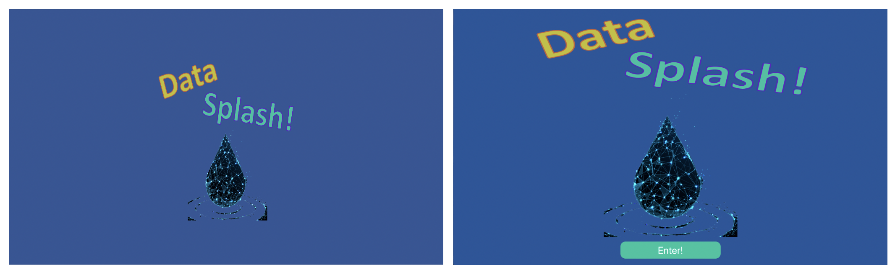
Design

Slide 13
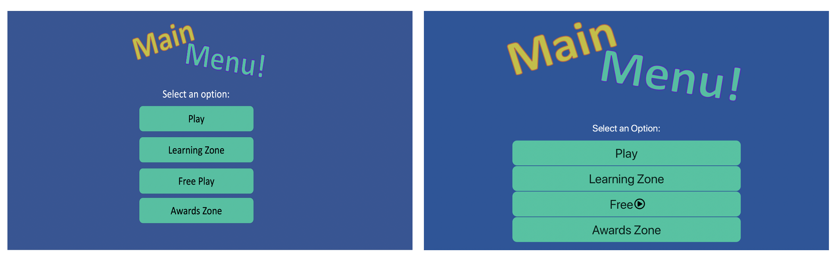
Design

Slide 14
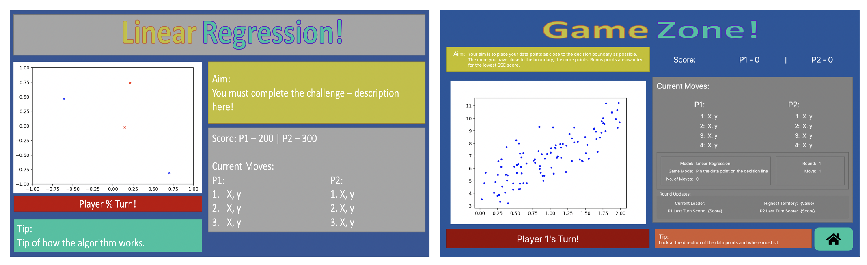
Design

Slide 15
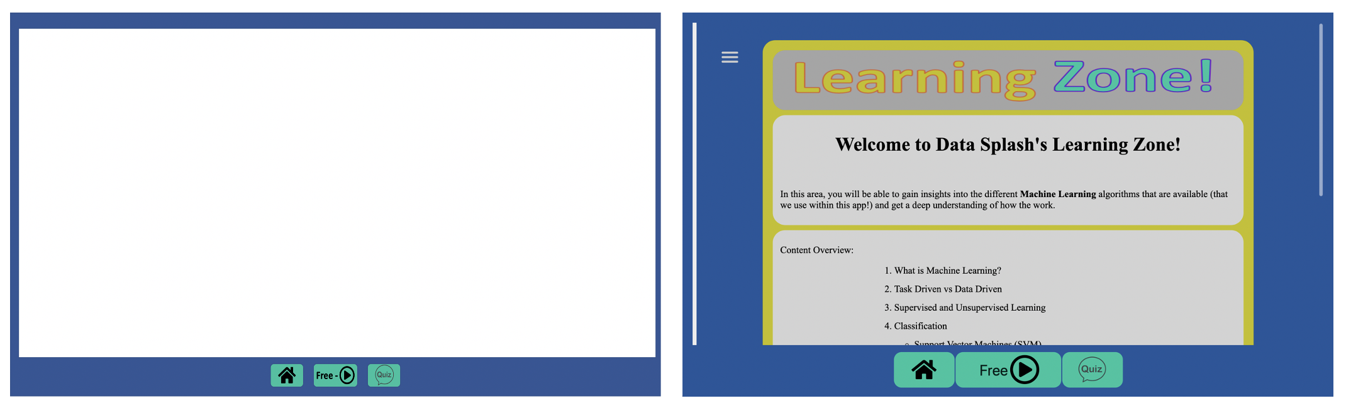
Design

Slide 16
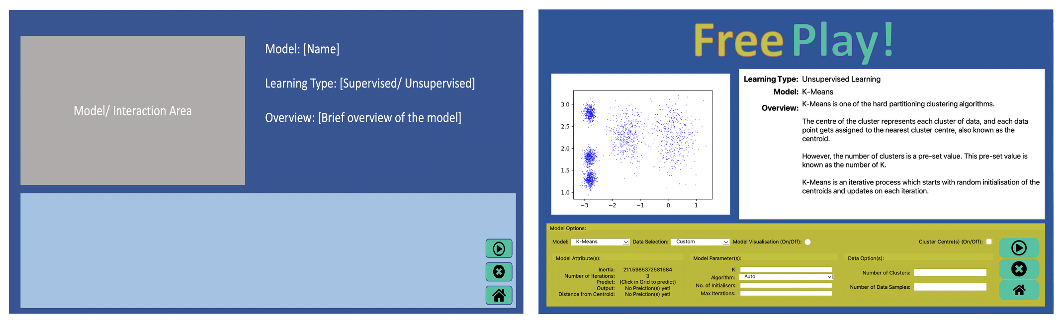
Design

Slide 17
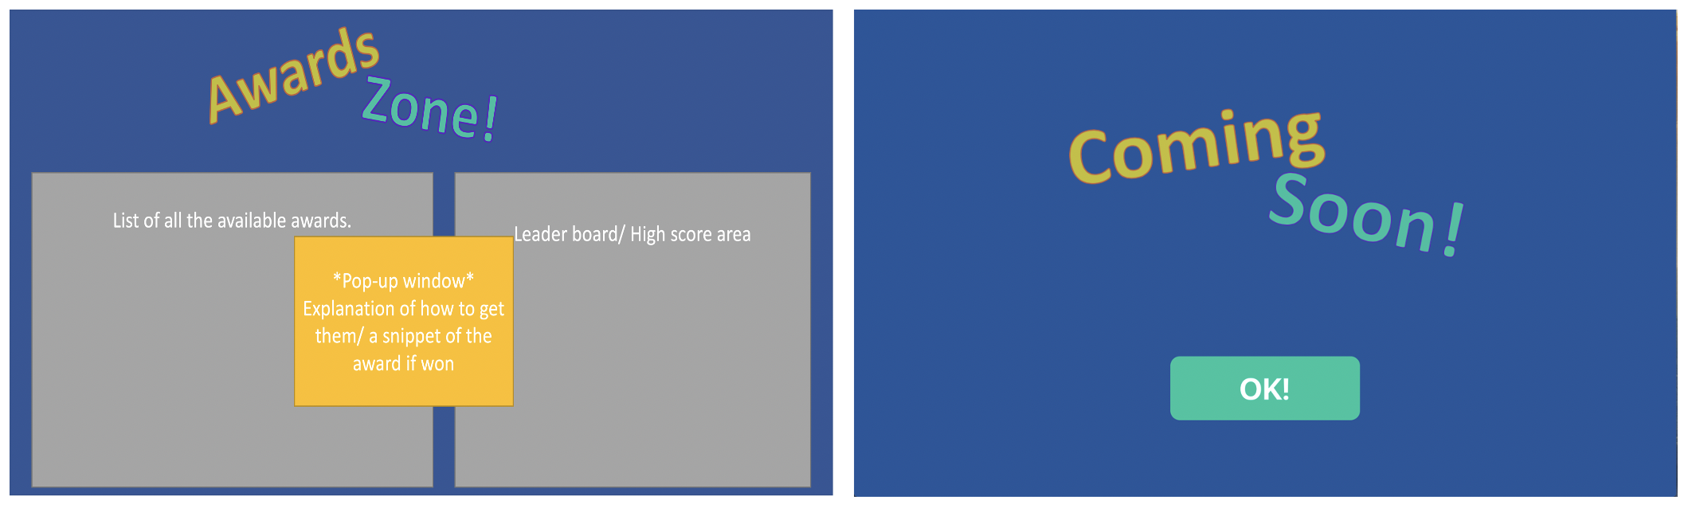
Design

Slide 18
Overview
Objectives
Project Proposal
Background
Design
Implementation
Results
Conclusion
Future Work

Slide 19
Implementation
Programming Language: Python
GUI Library: PyQT5
Additional Libraries:
Sci-Kit Learn
TensorFlow
Numpy
Code was completed in a modular way
Pandas

Slide 20
Demonstration

Slide 21
Overview
Objectives
Project Proposal
Background
Design
Implementation
Results
Conclusion
Future Work

Slide 22
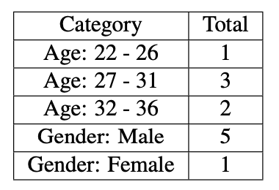
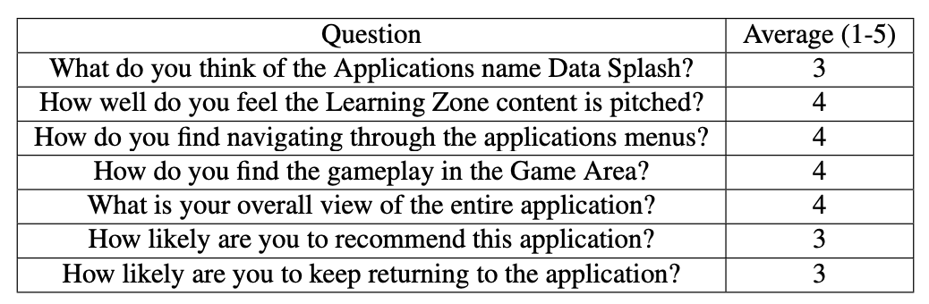
Results

Slide 23

Results
"Very informative and creative"
"A good learning experience"
"A good tool to enhance users knowledge.”
"Learning about complicated topics in a game context is quite easier and fun, where it involves interaction. “
“The application provide a good interaction through the quiz, free game and game area that involves two players."

Slide 24

Results
”I think it’s a good concept, but there is a fair bit of work to be done with layout and design to suit the target audience.”
”Change the design - less is more!”

Slide 25
Results
The area that was enjoyed the most was the Free Play area.
"Free Play is the most interesting part of the app as it lets the user to do many mistakes and learn by try-and-error"
"I like the free play area were you can select the model you want to learn about, and I think that the free play area prepares you for the real game that includes two players."

Slide 26
Overview
Objectives
Project Proposal
Background
Design
Implementation
Results
Conclusion
Future Work

Slide 27
Future Work
Adapt the UI
The ability to allow players to be able to face off against each other online
Add the feature of extra players
Quiz questions get stored in a cloud database
Create a web GUI to the game and host the entire application online
Users to use own datasets

Slide 28
Overview
Objectives
Project Proposal
Background
Design
Implementation
Results
Conclusion
Future Work

Slide 29
Conclusion
Five out of Six Objectives Met
Overall Positive Results
Main Negatives were on the UI
Many Potential Future work
Notes:
Must provide the users with an interactive GUI, allowing them to be able to navigate through the application and interact with its contents. (Done)
The application must have a game mode to let the users be able to have a competitive element to the application. (Done)
The application must have implemented multiple ML Models to enable the user to interact with them in some way. (Done)
The application must provide a form of teaching and learning content, allowing the users to learn about ML and the models more than just playing the game mode. (Done)
The application must have some aspects of gamification (Done)
and have unlockable available to the user (not done).

Slide 30

Q&A
Thank you for listening
Any Questions?

